Slide 1
AWS Solutions Architect Associate
Exam Break down and IAM

Slide 2
Content Outline
Domain 1: Design Resilient Architectures 34%
Domain 2: Define Performant Architectures 24%
Domain 3: Specify Secure Applications and Architectures 26%
Domain 4: Design Cost-Optimized Architectures 10%
Domain 5: Define Operationally Excellent Architectures 6%

Slide 3
Domain 1: Design Resilient Architectures (34%)
1.1 Choose reliable/resilient storage.
1.2 Determine how to design decoupling mechanisms using AWS services.
1.3 Determine how to design a multi-tier architecture solution.
1.4 Determine how to design high availability and/or fault tolerant architectures.

Slide 4
Domain 3: Specify Secure Applications and Architectures (26%)
3.1 Determine how to secure application tiers.
3.2 Determine how to secure data.
3.3 Define the networking infrastructure for a single VPC application.

Slide 5
Domain 2: Define Performant Architectures (24%)
2.1 Choose performant storage and databases.
2.2 Apply caching to improve performance.
2.3 Design solutions for elasticity and scalability.

Slide 6
Domain 4: Design Cost-Optimized Architectures (10%)
4.1 Determine how to design cost-optimized storage.
4.2 Determine how to design cost-optimized compute.

Slide 7
Domain 5: Define Operationally-Excellent Architectures (6%)
5.1 Choose design features in solutions that enable operational excellence.

Slide 8
Identity Access Management (IAM)
securely control individual and group access to your AWS resources
create and manage user identities ("IAM users") and grant permissions for those IAM users to access your resources
can also grant permissions for users outside of AWS (federated users)
MFA
Password rotation policy
Supports PCI DSS compliance (credit cards)

Slide 9
Key terminology for IAM
Users – end users, employees
Groups – Collection of users
Policies – made of documents called policy documents formatted in JSON, they give permission to user/group/role
Roles – roles are assigned to AWS resources

Slide 10
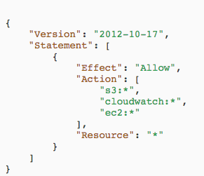
IAM
Is Global, not region specific
MFA – Virtual MFA device (google authenticator), U2F security (hardware), hardware MFA device (other hardware)
Users – programmatic (access key, secret key for AWS CLI, API, SDK) or console access, require to change password (option)
Groups- AWS managed policies can be added to groups, for e.g. AWSAdminAccess, permission boundaries can be added to restrict access to only certain AWS resources

Slide 11
IAM
Password policy can be modified under account settings. ou can use the policy simulator using the AWS SDKs or AWS CLI in addition to the policy simulator console. Use the iam:SimulatePrincipalPolicy API
Under Security credentials – console password, MFA can be managed, SSH keys can be uploaded for access to CodeCommit repos, HTTPS Git creds can be generated
Roles – can be applied to AWS resources, other AWS account resources, Web Identity (Cognito), SAML 2.0. These services will perform actions on your behalf’. trusted entities assume roles, such as IAM users, or AWS services such as EC2. You can change roles on running EC2 instance, with ASG. Cannot assign more than one role with EC2

Slide 12
IAM
Identity providers - If you already manage user identities outside of AWS, you can use IAM identity providers instead of creating IAM users in your AWS account. With an identity provider (IdP), you can manage your user identities outside of AWS and give these external user identities permissions to use AWS resources in your account.
Credential report – downloads a report listing all account’s users
Encryption keys - AWS Key Management Service (AWS KMS) is a managed service that makes it easy for you to create and control the encryption keys used to encrypt your data. The master keys that you create in AWS KMS are protected by FIPS 140-2 validated cryptographic modules.

Slide 13
IAM - Misc
Policies –
User policy size cannot exceed 2,048 characters.
Group policy size cannot exceed 5,120 characters.
Role policy size cannot exceed 10,240 characters.
Billing – costs $0, does not provide cost breakdown by user,
MFA-protected API access is optional functionality that lets account administrators enforce additional authentication for customer-specified APIs by requiring that users provide a second authentication factor in addition to a password.
Power user – is not same as admin user. Power user does not have access to management functions
When new user is created by default there is no access

Slide 14
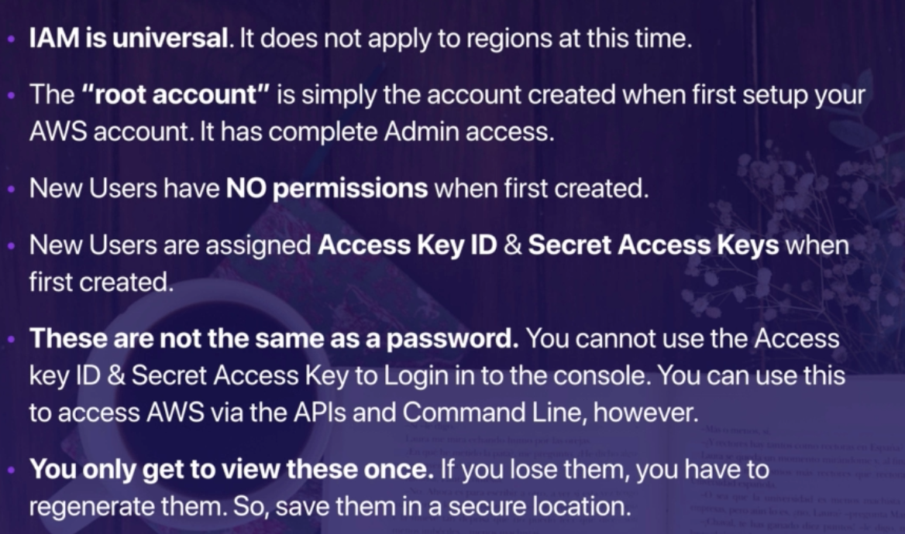
Summary

Slide 15
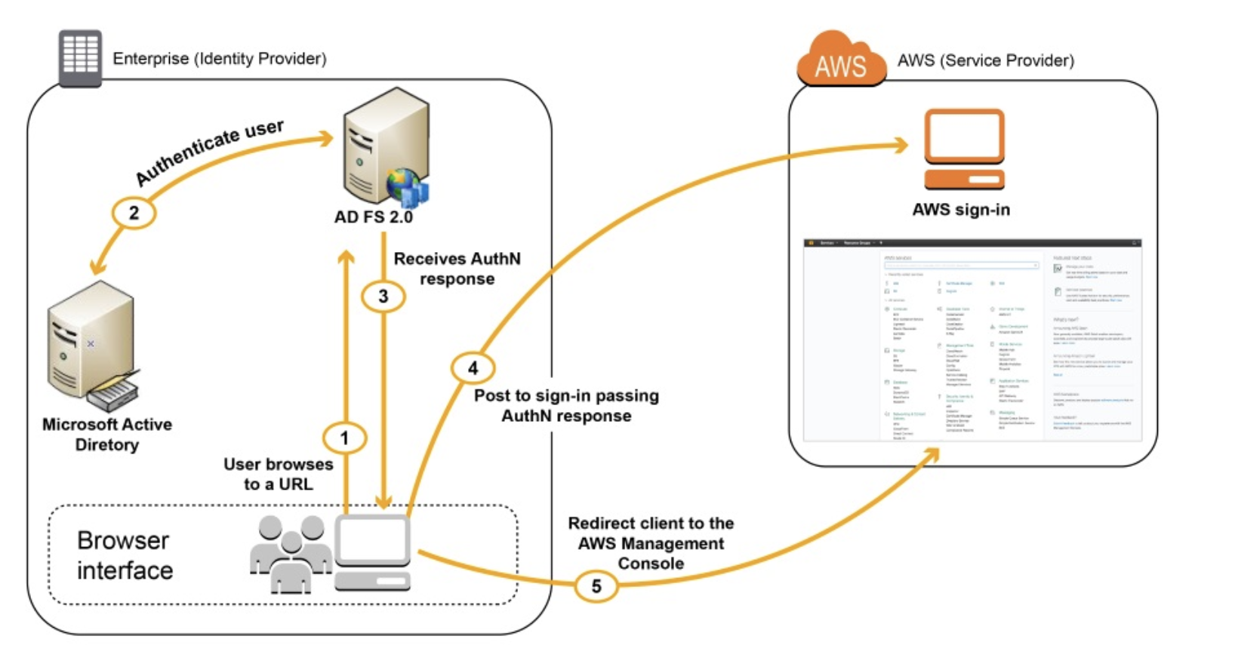
More stuff
Federated login –
Notes:
Federated login using - SAML assertion

Slide 16

More stuff
IAM is free
User can have cross account access
Groups cannot belong to other groups
IAM - AWS access key, X.509 certificate, SSH key, password for web app logins, or an MFA device
User access can be disabled via AWS SDK
Root account holder or adminaccess policy can allow IAM management
IAM is global

Slide 17
More stuff
Rotation can be set for keys
Cannot make resource specific keys
SSH keys are used for codecommit repo access
No limits on users
IAM users, applications, or AWS services such as EC2 can assume roles
IAM roles allow for delegation without need of keys
assume an IAM role by calling the AWS Security Token Service (STS) AssumeRole APIs

Slide 18
More stuff
Role can be changed on running EC2
Permissions on who can assume role managed in role – passrole
Service linked role – only specific service can assume
Temporary security credentials - can be generated using STS
Max policy size: 2048 bytes
iam:* needed to activate/deactivate STS
IAM Access to billing can be enabled. Disabled by default

Slide 19

Advanced IAM – Developer Course
Web Identity Federation
Let’s users access AWS after authenticating web identity providers like Facebook, Amazon or Google
Service is called: Cognito
Device agnostic – for e.g. same UX for mobile vs web app
No need to embed AWS credentials on devices
User Pools
Directories to manage user sign-in and sign-up
Either sign in directory into user pool or via cognito
Identity Pools
Create identity to obtain temporary credentials
Cognito does push sync of user data to users

Slide 20
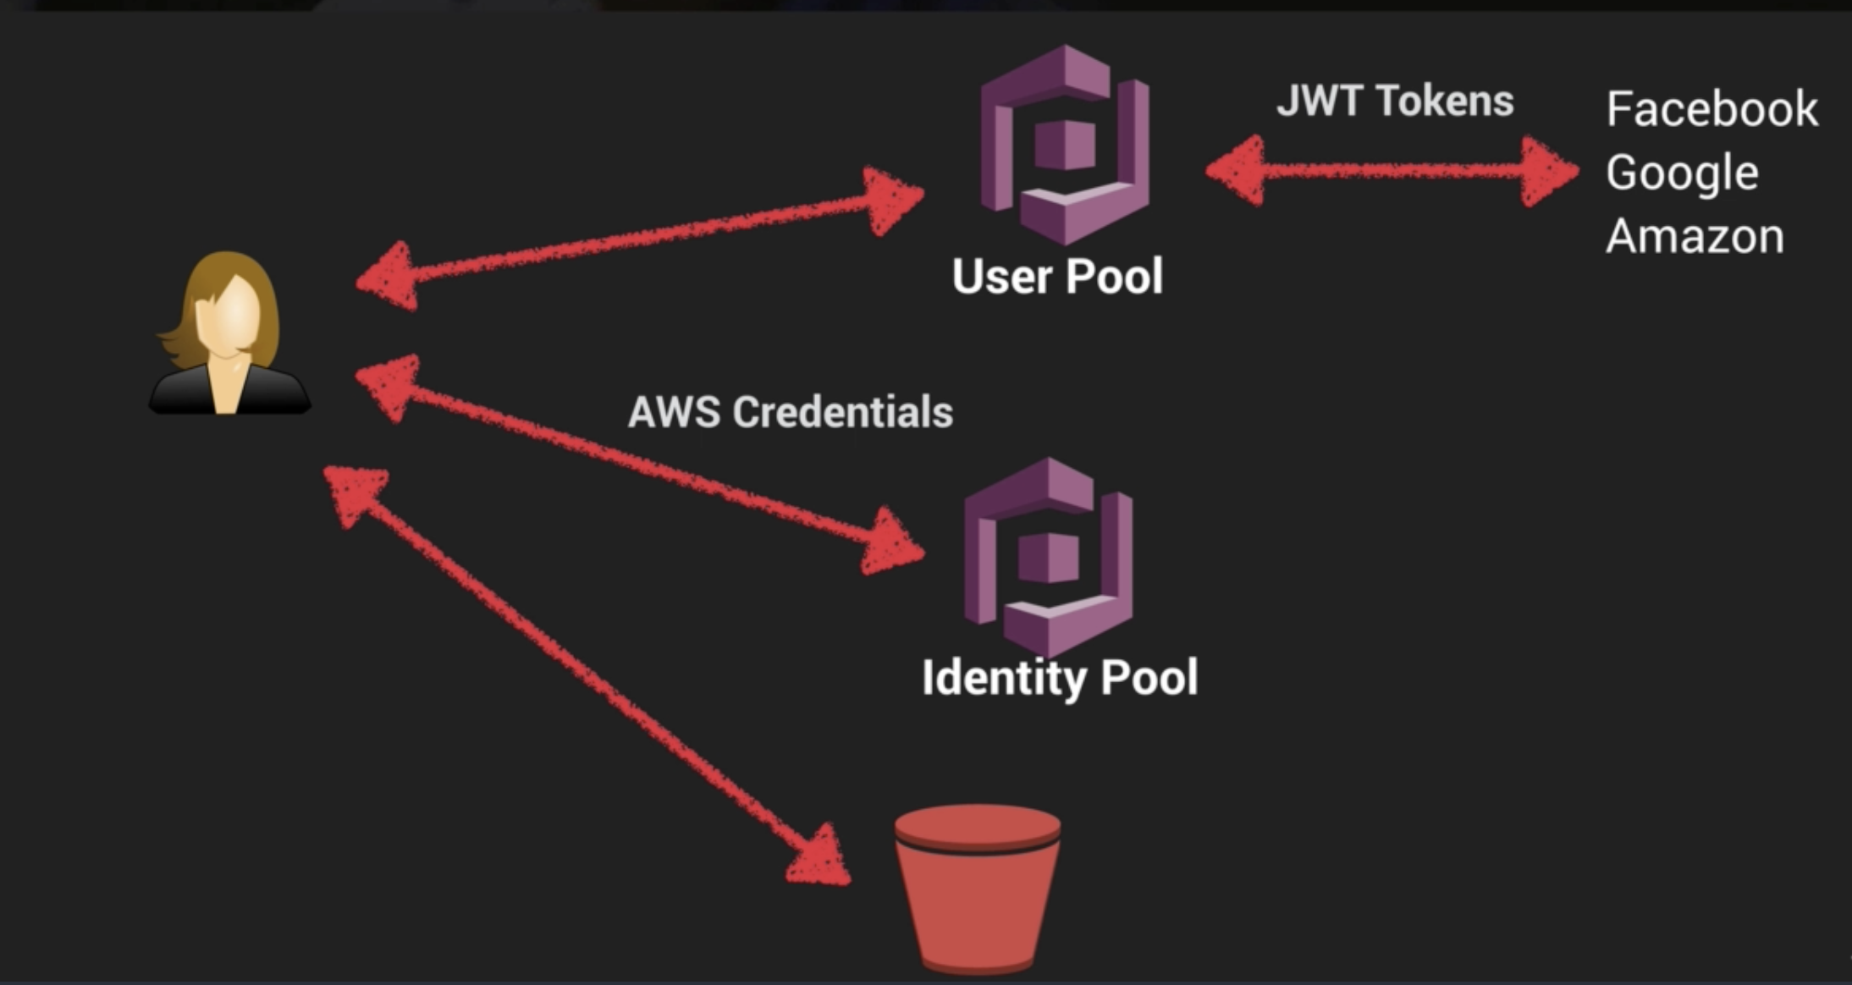

Slide 21
IAM Policies
Managed: Created and administered by AWS. Cannot be changed.
Customer: Stand alone policy used within your own account
In-line: Only recommended if it only applies to specific user, group or role

